Slide 1

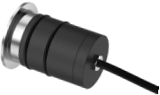
2026 New Product: MA Series In-ground Light
December 2026 Version B
广州励鑫照明灯具股份有限公司

Slide 2








MA Series In-ground Light
Model and Power
MA-32
1W
MA-42
2~3W
MA-50
4~5W
MA-64
6~8W
MA-80
10~12W
MA-100
15~18W
MA-120
18~24W

Slide 3





MA Series In-ground Light
Dimensional drawing
MA-32 1W
MA-42 2~3W
MA-50 4~5W
MA-64 6~8W

Slide 4

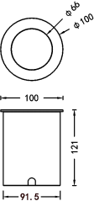
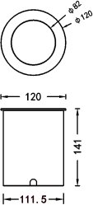

MA Series In-ground Light
Dimensional drawing
MA-80 10~12W
MA-100 15~18W
MA-120 18~24W

Slide 5





MA Series In-ground Light
Lighting parameters and configuration
Model:MA42 3W
Light Source Specification:3535 18V 5W（special make）
Lens size: Φ22* H12 mm
Lens angle: 8/10/15/24/36/50/60°
Light Dimensions: ф42*77mm
Hole size: ф40*110mm
Model:MA32 1W
Light Source Specification: 3535 18V 3W（special make）
Lens size:Φ 16* H8.5 mm
Lens angle:15/24/36/50/60°
Light Dimensions:ф32*71mm
Hole size:ф29*100mm

Slide 6



MA Series In-ground Light
Lighting parameters and configuration
Model:MA64 8W
COB Specification:CREE CXA1304
COB Size:13.35*13.35/ ф6mm
Lens Size:Φ28.8*H16.5mm（Includes COB holder）
Lens angle:10/15/24/36/50/60°
Light Dimensions:ф65*95mm
Hole size:ф58*130mm
Model:MA50 5W
COB Specification:CREE CXA1304
COB Size:13.35*13.35/ ф6mm
COB Size:Φ25* H15mm（Includes COB holder）
Lens angle:10/15/24/36/50/60°
Light Dimensions:ф50*85mm
Hole size:ф46*120mm

Slide 7




MA Series In-ground Light
Lighting parameters and configuration
Model:MA100 15~18W
COB Specification:CREE CXA1512
COB Size:15.85*15.85/ ф9mm
Lens Size:Φ 55*H30 mm（Includes COB holder）
Lens angle:10/15/24/36/50/60°
Light Dimensions:ф100*121mm
Hole size:ф94*150mm
Model:MA80 10~12W
COB Specification:CREE CXA1507
COB Size:15.85*15.85/ ф9mm
Lens Size:Φ 35* H20 mm（Includes COB holder）
Lens angle:10/15/24/36/50/60°
Light Dimensions:ф80*108mm
Hole size:ф74*140mm

Slide 8
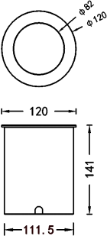
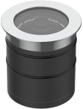
MA Series In-ground Light
Lighting parameters and configuration
Model:MA120 24W
COB Specification:CREE CXA1816
COB Size:17.85*17.85/ ф12mm
Lens Size:Φ75* H40 mm（Includes COB holder）
Lens angle:10/15/24/36/50/60°
Light Dimension:ф120*141mm
Hole size:ф114*170mm

Slide 9





MA Series In-ground Light
Anti-glare solution
Type A
Deep Cup + Honeycomb Core
Type B
Radome+Honeycomb core
Type C
Deep set anti-glare
Type D
Radome anti-glare

Slide 10







MA Series In-ground Light
Panel solution
Ⅰ-Round
Ⅱ-Square
Ⅲ-Translucent
Ⅳ-Double light transmission
Ⅴ-Triple light transmission
Ⅵ-Quad light transmission

